Slide 1
Eye For the Blind
Dinesh Vhatte
Capstone Project Year 2 - MS in Data Science, University of Arizona
Image Captioning with Attention Mechanism for Accessibility
Enhancing Image Understanding for the Visually Impaired

Slide 2
Introduction
Objective: To generate descriptive captions for images, convert them to speech, and assist visually impaired individuals.
Relevance: This project aims to bridge the gap in accessibility, allowing visually impaired users to comprehend visual content through auditory means.

Slide 3
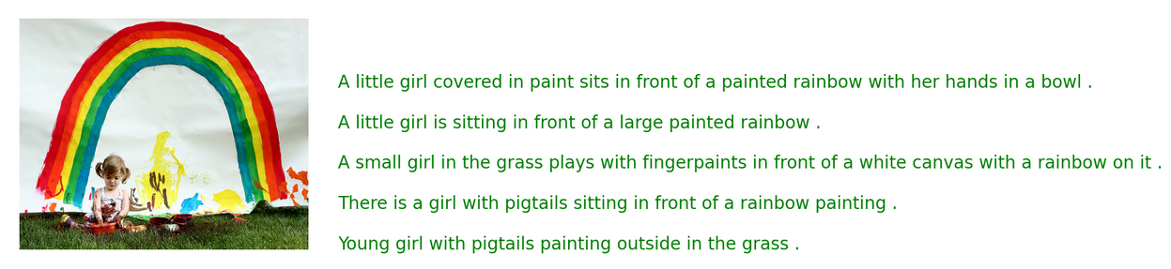
Dataset Overview
Source: The dataset is sourced from Kaggle's Flickr8K dataset.
Content: The dataset contains 8,000 images, each annotated with five unique captions.

Slide 4
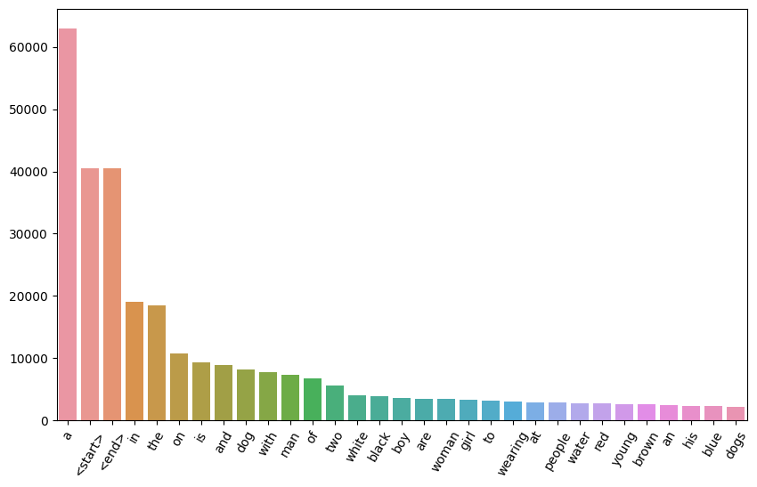
Project Pipeline
Data Understanding:
Description: Load and examine the dataset to understand its structure.
Data Preprocessing:
Steps:
Resizing and normalizing images.
Tokenizing captions and building a vocabulary.
Train-Test Split:
Description: Split the dataset into training and testing sets.
Model Building:
Components:
CNN Encoder: Extracts image features.
Attention Mechanism: Focuses on important parts of the image.
RNN Decoder: Generates captions.
Model Evaluation:
Metrics: BLEU score and qualitative assessments.
word count
word

Slide 5
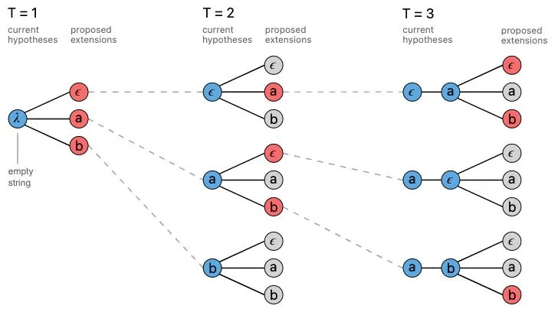
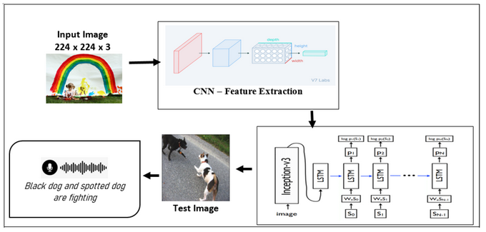
Model Architecture
Encoder (CNN):Extracts features from images.
Attention Mechanism:Allows the model to focus on different parts of the image.
Decoder (RNN):Generates captions using image features and attention weights.
Attention Mechanism – Beam Search

Slide 6
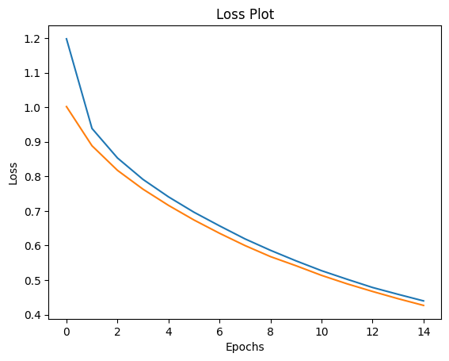
Training Process
Adam optimizer is used during training
Model trained with 15 epochs
Loss plot obtained for each epoch
Model shows very good convergence

Slide 7
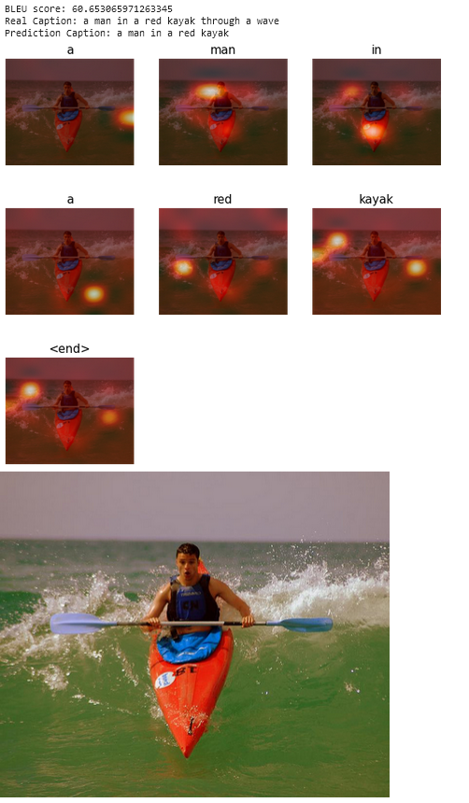
Model Evaluation and Prediction on Unseen Data
Metrics: BLEU (Bilingual Evaluation Understudy) is a metric for evaluating the quality of text generated by machine translation models by comparing it to one or more reference translations. Scores range from 0 to 1, where 1 indicates perfect similarity.
For the sample test we had
BLEU score: 60.65
Real Caption: a man in a red kayak through a wave
Prediction Caption: a man in a red kayak

Slide 8
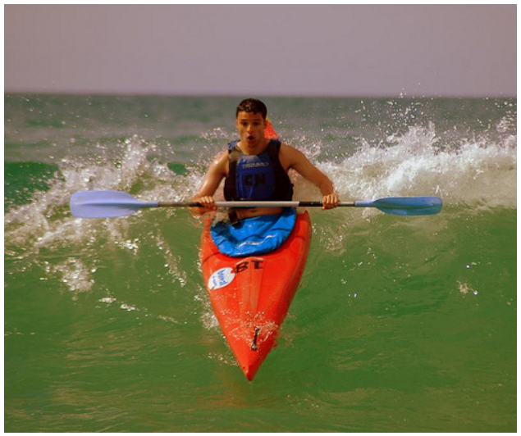
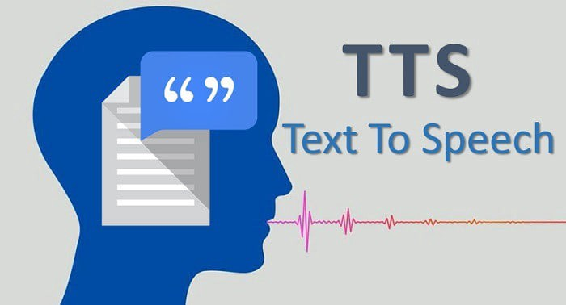

Conversion to Speech
Test Image
Text-to-Speech (TTS): Google Text To Speech is used for converting the generated Image caption to Audio
Demo:
Generated Caption for the test Image - a man in a red kayak
Click on this icon to run the demo audio

Slide 9
Impact and Future Work
Impact: The project helps visually impaired people to visualize the image via the audio they listen to.
Improvements: Deployment of model to wearable devices to help visually impaired people.

Slide 10
Conclusion
Summary: We have successfully built ENCODER Decoder based model with enhanced attention model for better image captioning. The captions were then converted to audio to help visually impaired people
Acknowledgments: thanks a lot, to all the support and seamless learning experience from Upgrad team and university of Arizona.

